Slide 1
Predicting Flight Delays
By: Zachary Argentin, Gustavo Cárdenas

Slide 2
The Problem
The impact of flight delay can result in financial losses, the dissatisfaction of passengers, time losses, loss of reputation and bad business relations.
If an airline doesn't deal with the problem of flight delays, it will cause other problems.

Slide 3
The Solution
Using machine learning to predict whether a flight will be delayed 1 week before it is scheduled for departure.
Knowing this information in advance, the company can take proactive measures to mitigate the negative effects caused by the delay, or perhaps even to prevent the delay altogether.
An accurate machine learning model can help identify the causes of flight delays and therefore assist the company in preventing delays in the future.

Slide 4
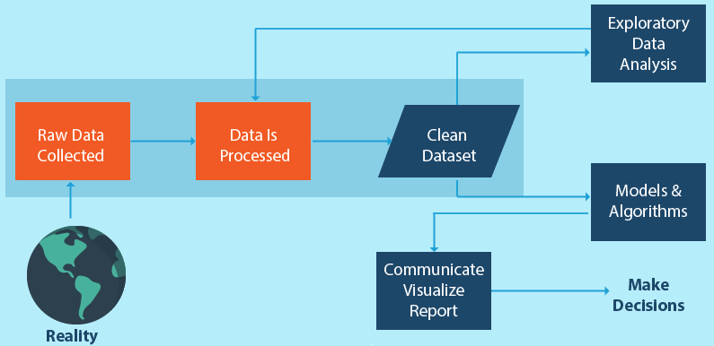
Process
Data selection and collection
Data exploration - wrangling - engineering
Model selection - model testing
Feature re-engineering
Model re-testing
Making a prediction

Slide 5
Data
Dataset of all domestic flights in the USA from 2018 and 2019
~16 million flights
We took a random sample of about 400,000 of those flights
The dataset included information about the arrival delay of each flight, which was our target variable.
The dataset also included features that needed to be transformed in order to be useful, like the times in military format, or the date lacking format at all.
Other variables were not useful at all, like the “diverted”, “dup” or “no name” as an example

Slide 6
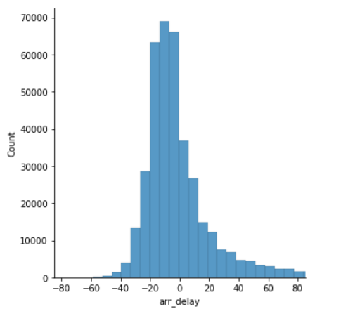
Data exploration
Test hypothesis that the delay is from Normal distribution.

Slide 7
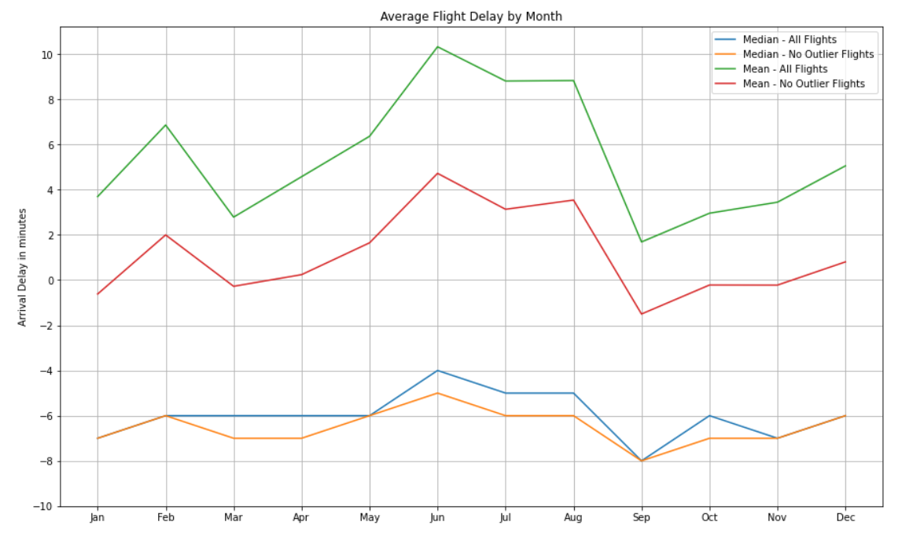
Data exploration
Average/median monthly delay different during the year
Outliers comparison

Slide 8
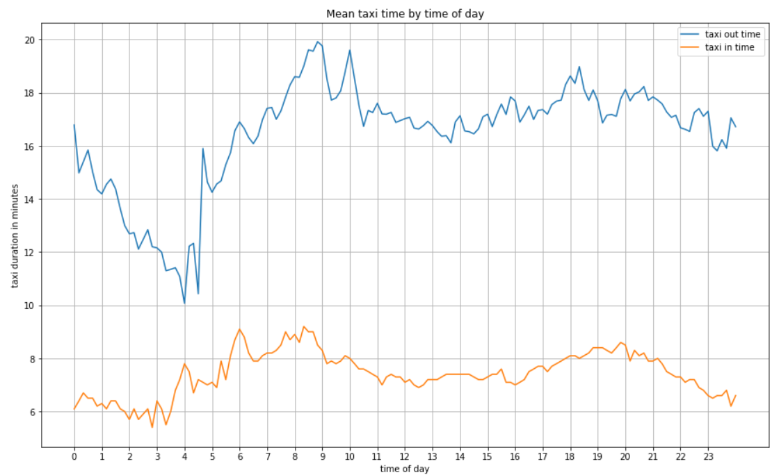
Data exploration
How taxi times changing during the day?
Does higher traffic lead to bigger taxi times?

Slide 9
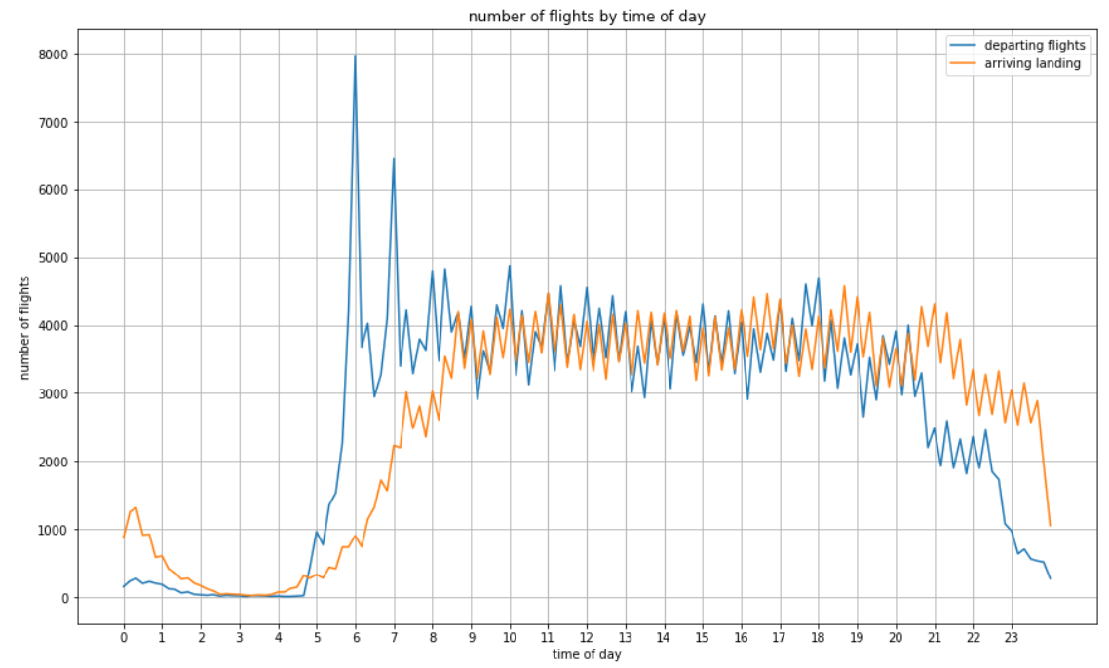
Data exploration
Number of departing flights and arriving flights by time of day.

Slide 10
Feature Selection & Modeling
We used descriptive statistics from the dataset as features for a linear regression, polynomial regression, and random forest model.
An example of a few of the features that were used :
Average flight delay by carrier
Average flight delay by origin and destination airport
Scheduled flight departure time
Distance of flight
Dummy variable creation

Slide 11
Results
The Polynomial regression model yielded the best result.
Using Polynomial Regression we were able to get an r_squared score of around 0.05
Given more time we would obviously like to improve this by:
Engineering more features and using feature selection techniques such as using a filter method or wrapper method
Experimenting with different models (Naive bayes, XG boost) and training on a larger dataset.
--Results---
degree = 2
Train score = 0.05822640007024771
Test score = 0.04997280416208816
Mean Absolute Error: 23.291247631336915
Mean Squared Error: 2361.4402712885085
Root Mean Squared Error: 48.594652702622625

Slide 12
Challenges
Data gathering - Selecting the size and nature for the data sample to work
Data engineering - Perform the necessary data transformations and feature selection
Data exploration for model selection
Feature selection for model training

Slide 13
Limitations
Computational power - consider a larger base sample and a greater number a variables
Time constraint

